Slide 1
Emotional Elections
Using Twitter Data to Gauge how Public Feelings Change Between and Around US Elections
Aly Axness MTH391 Spring 2025

Slide 2
My Questions
@twitter
How have attitudes about US elections changed over time?
Are people posting more positive or negative content surrounding US elections?
Have our conversations about elections become more negative over time?
1036
3671
54.6K
Notes:
15min
10 slides
Visuals
Focused
Jargon-free for mixed audience

Slide 3
Methods – Twitter Timeline
@twitter
The Data
2012-2020
#USElection, #Election2016, #Election2018, #Election2020
Analysis
2 sentiment analysis models: VADER and LIWC
Sentiment analysis: quantifying emotions expressed in text
Visualization
Line, dot, box plots, pie charts
Look for patterns
Interpretation
Cross Reference with Election Events
What can we learn?

Slide 4
Home
Search Twitter
Home
What’s happening?
Explore
Tweet
Notifications
Messages
Anonymous
@anonymous
Nov 2020
Bookmarks
bloody hell florida #uselection
Lists
Show this thread
Profile
@anonymous
Anonymous
Nov 2020
Lists
just joy here. joy and enormous relief #georgia #uselection
Tweet
Sentiment Analysis Examples
@twitter
Ipsum
@ipsum0

Slide 5
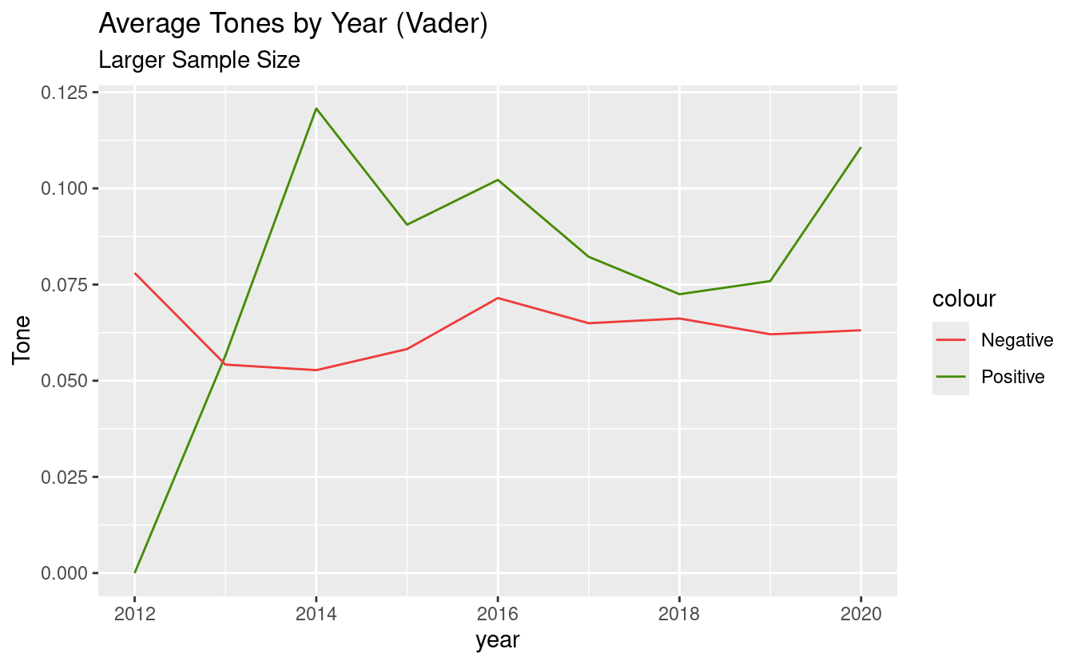
#USElection
: 50,000
Notes:
Pos over neg
2016 neg

Slide 6
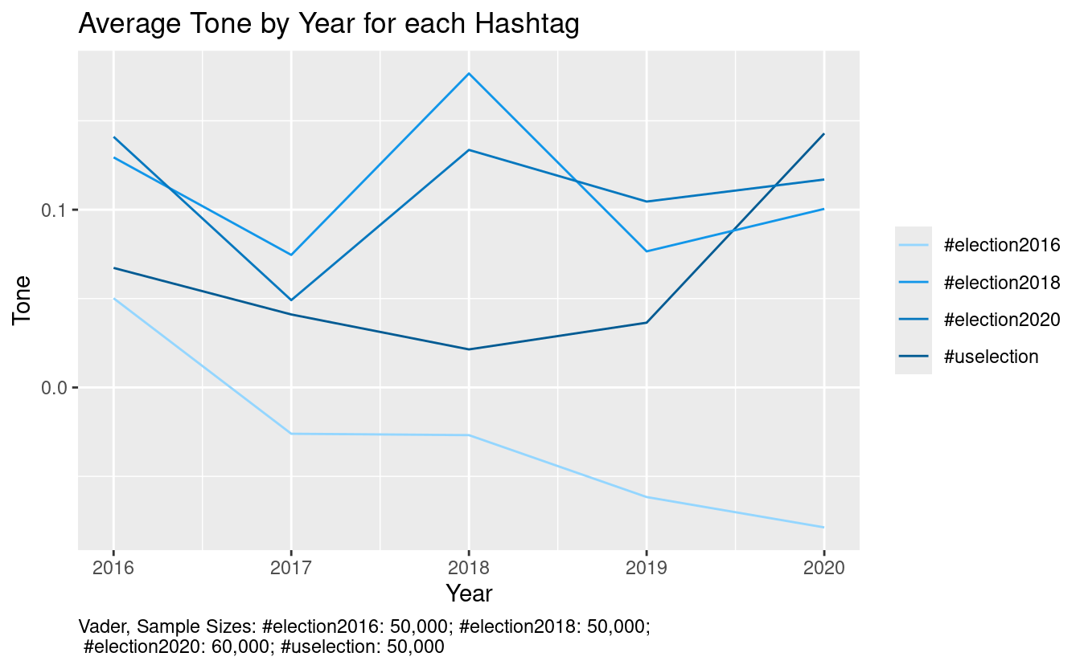
Notes:
2020 and 2016 neg, 2016 more so

Slide 7
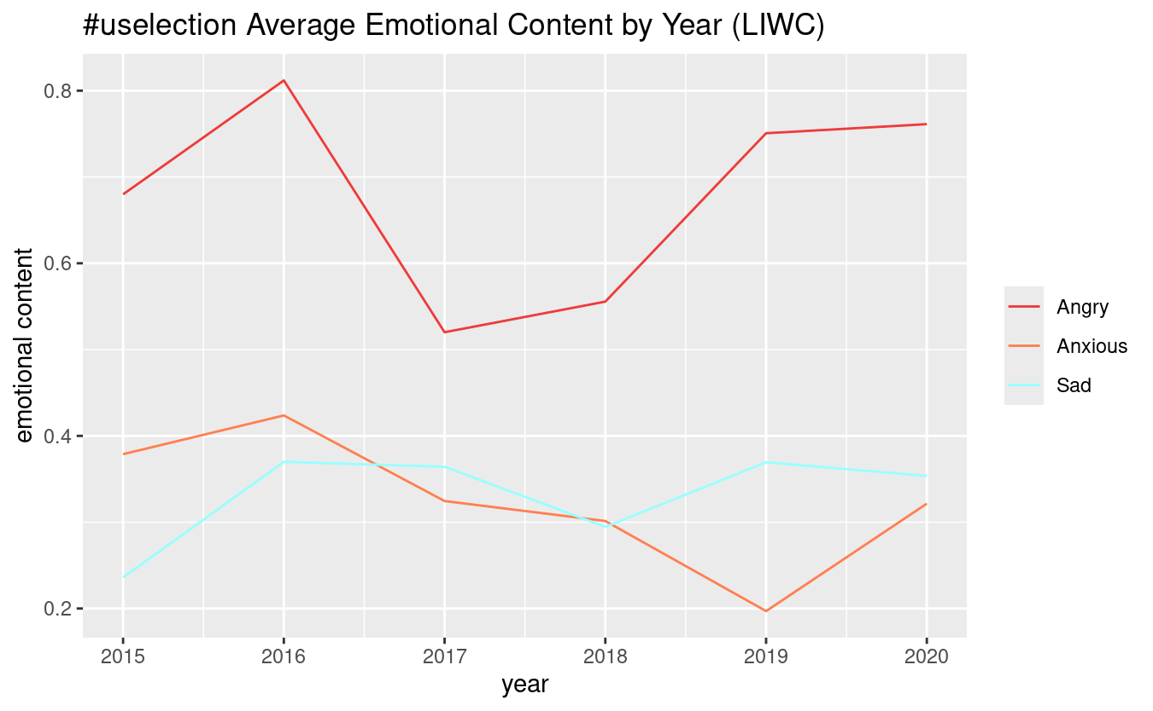
Notes:
anger!!

Slide 8
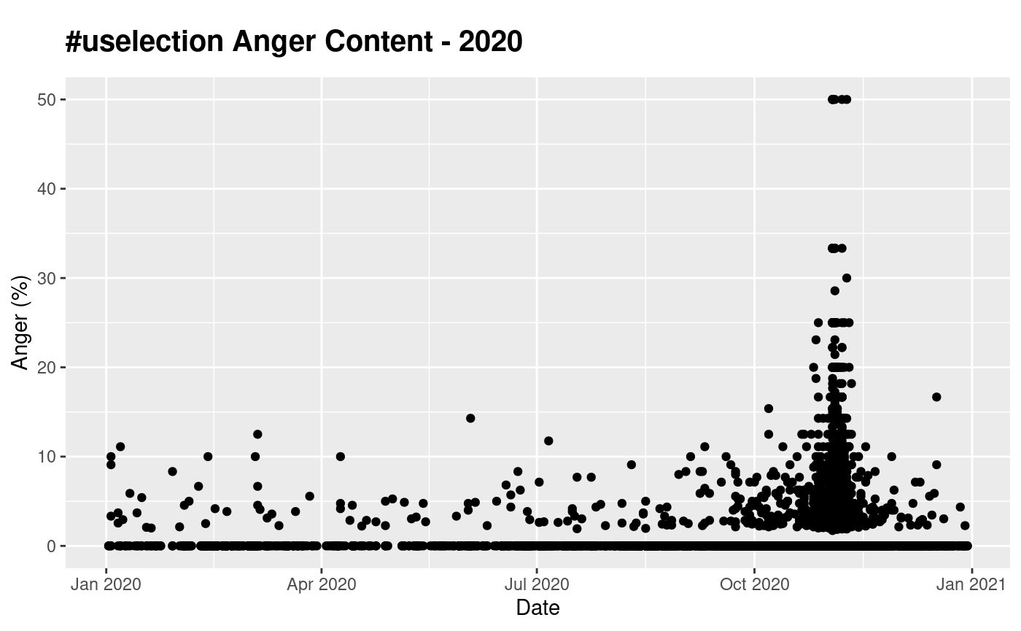
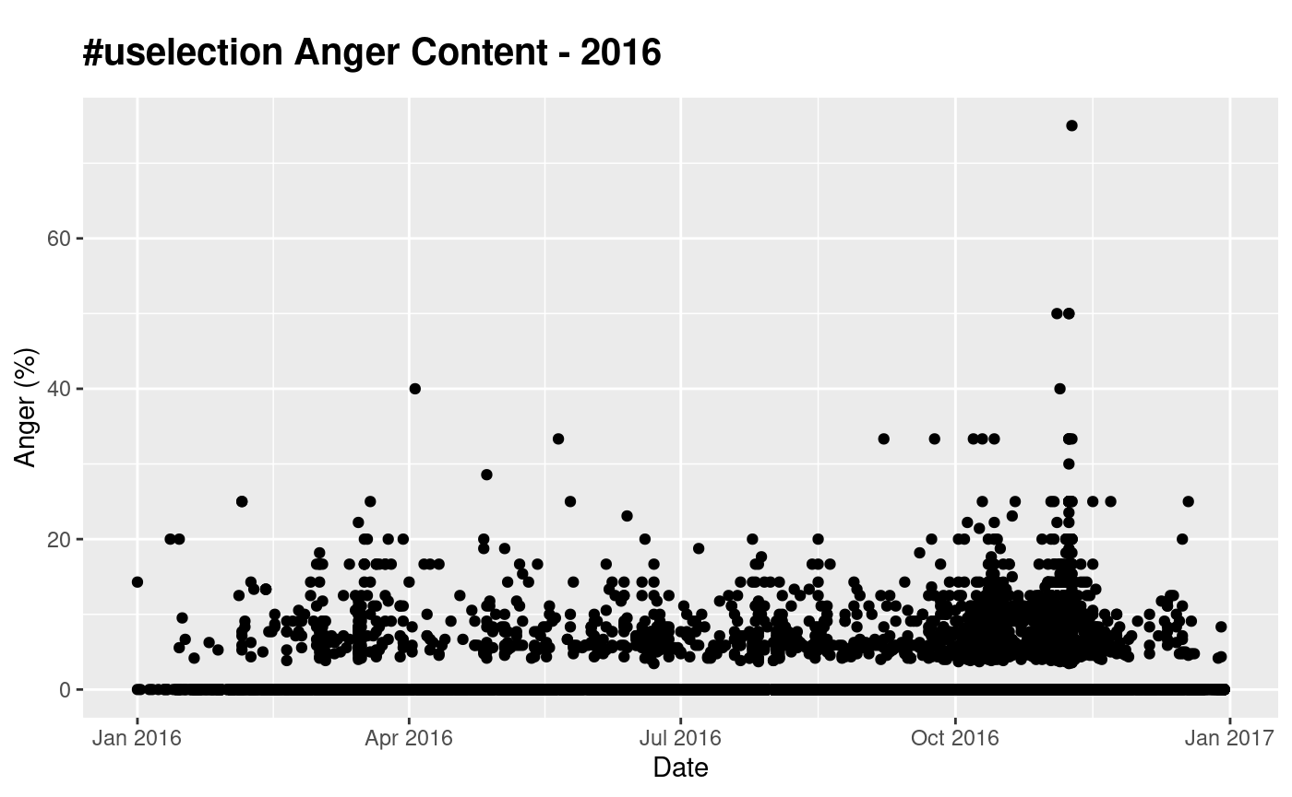

Slide 9
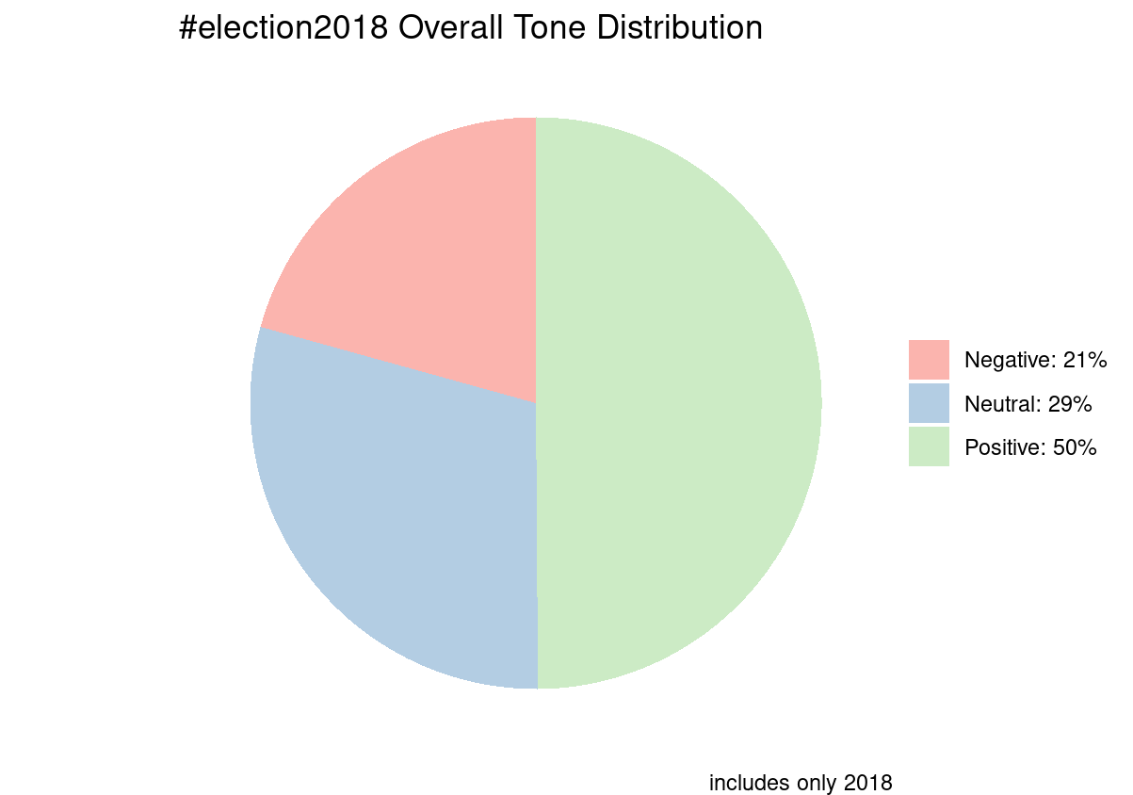
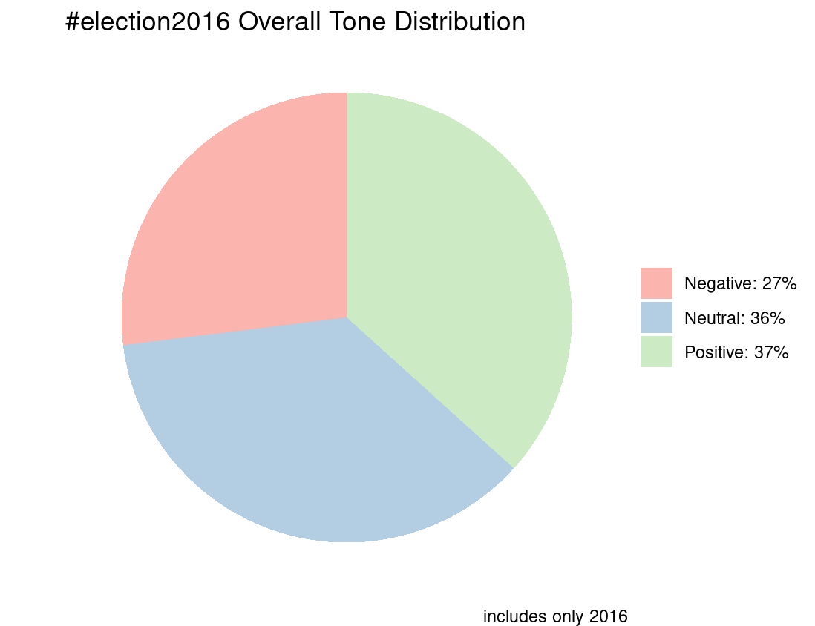

Slide 10
Conclusions/Results
@results
Heightened emotions are tightly correlated with election events
Especially Presidential
Generally, more positive language than negative
Trends seem to be moving towards positivity, generally
2016 was very contentious

Slide 11
Thank You!
Questions?

Slide 12
Slide Chef

