Slide 1
Apple iOS App Store vs Google Play Store
Isaac Ajayi

Slide 2
Research Question
Which app categories are rated higher on the Apple App Store compared to the Google Play Store?
What insights do these ratings provide on user preferences?

Slide 3
Datasets
Author: Lavanya Gupta 2019
googleplaystore.csv
App name, category, rating, number of reviews, number of installs
10,000+ data points
googleplaystore_user_reviews.csv
Reviews, sentiment (positive, negative, neutral), sentiment subjectivity
Author: Gautham Prakash
appleAppData.csv
App name, Genre, Rating, size, price, number of reviews
1.1 million+ data points

Slide 4
Objectives
Visualize each platform’s top 3 highest average rated categories
Visualize how app ratings vary by year and genre
Perform sentiment analyses on Google Play app reviews using Vader

Slide 5
Visualizing Top 3 Highest Rated Apps
Converting all letters to lowercase
Removing and replacing symbols
“&” to “and”
“_” to “*space*”
Harmonize Category variables by creating a category map
"games" = "game", "books and reference" = "book", "graphics and design”= "art and design”
Google dataset had 33 categories while Apple dataset had 26
20 Comparable categories
“EDUCATION” to “education”

Slide 6
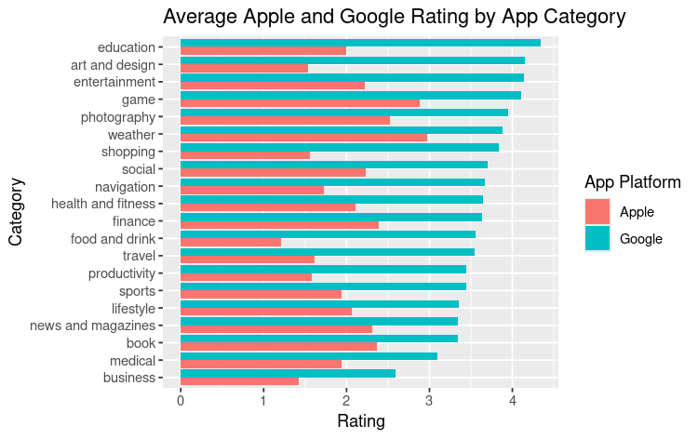
GOOGLE
APPLE
Top 3 Highest rated Google Genres
EDUCATION
ART AND DESIGN
ENTERTAINMENT
Top 3 Highest rated Apple Genres
WEATHER
GAME
PHOTOGRAPHY

Slide 7
How do app ratings vary by year and genre?
Consistently formatting latest Update date
Year/month/date to Year
Filter top 3 highest rated genres
Filter from between 2015 to 2022
Data before 2015 was inconsistent and scarce
Filtering the zero ratings in the Apple dataset
Zero ratings meant zero reviews

Slide 8
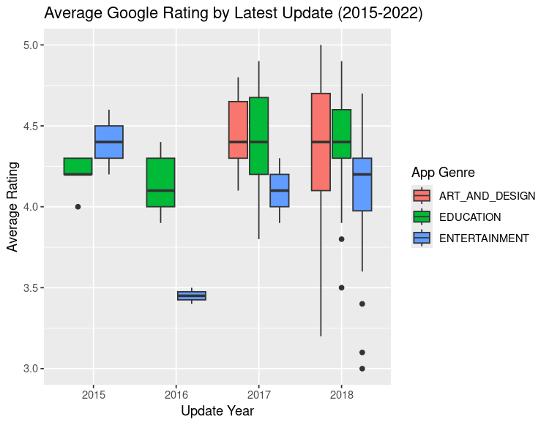
Entertainment is rated lower overall compared to other genres
Education apps are rated consistently throughout the years (4.2-4.6)
Art and design show high median ratings, but are not present before 2017
Games genre is most consistently rated at 4.5
Photography apps have a wider distribution of ratings, but median rating increases over time
Overall quality improves after 2018

Slide 9
Vader Sentiment Analysis
Only Google Play reviews dataset (865 unique apps)
Sentiment analysis performed in Jupyter notebook
Positive, negative, neutral, and compound
Averaged the compound sentiment for each app to get the overall sentiment

Slide 10
Strong positive sentiments:
Parenting
Health and Fitness
Education
Art and Design
Strong Negative sentiments:
Photography
Personalization
Video Players
News and Magazine
Photography apps had very polarizing sentiments. They are almost equal in positive and negative sentiment
Higher Rating does not mean better sentiment. Ex: Games category ranked high, but has a large negative sentiment

Slide 11
Limitations
Apple review datasets were either unavailable or too expensive
Differences in data coverage may skew results
Google data set 10,000 data points
Apple data set 1.1 million data points
Some genres have more apps and reviews

Slide 12
Impacts
Understanding different behaviors between Apple and Google users
Each platform caters towards different users
Understanding these user bases will inform developers where to focus marketing efforts and prioritize app development

Slide 13
Future Work
Find datasets similar in size
Perform sentiment analyses on an apple data set and compare sentiments between the two platforms
Consider analyzing more app genres
Compare other metrics such as retention rates or number of installations

